Slide 1
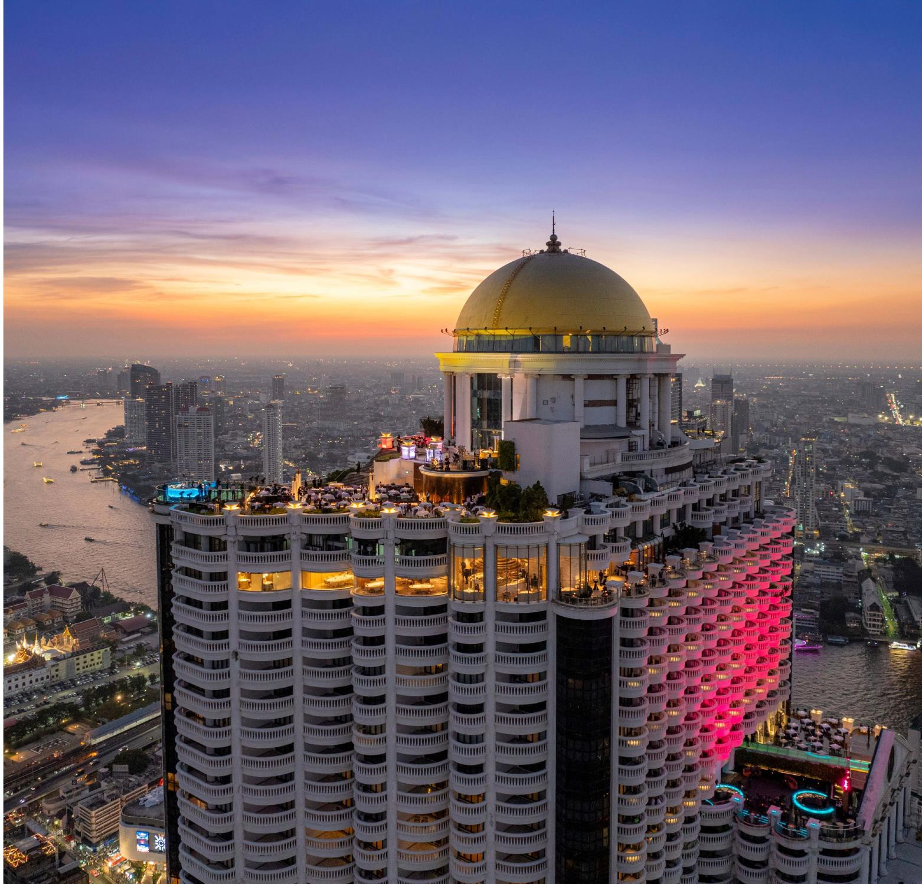


FUNCTION ROOMS
TARGET SUCCESS IN EXTRAORDINARY WAYS

Slide 2
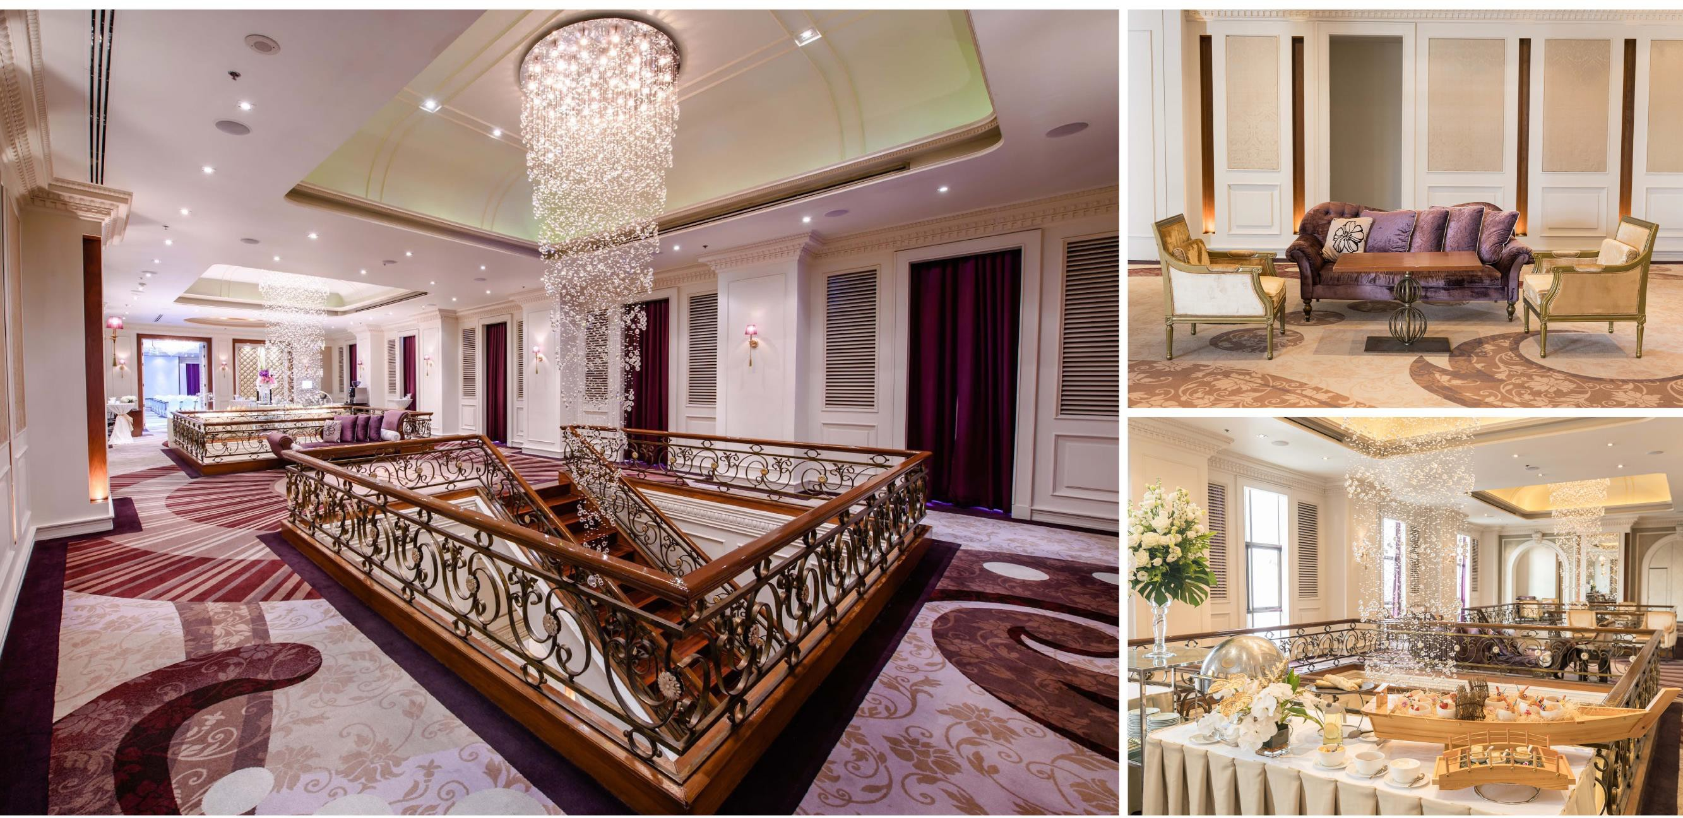

Slide 3
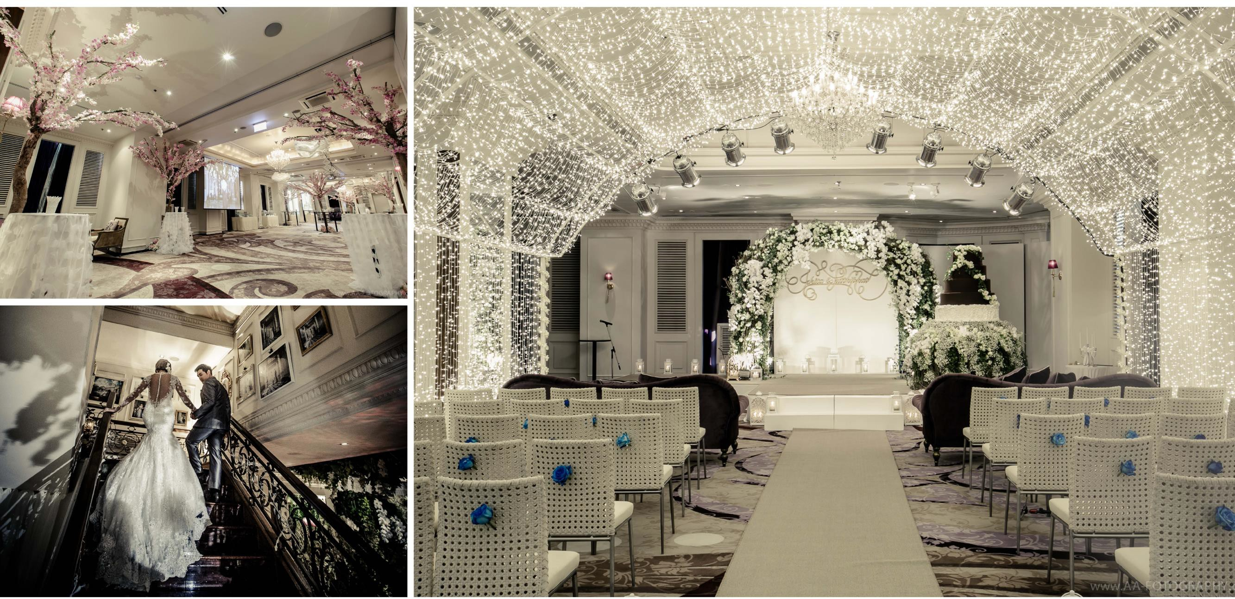

Slide 4
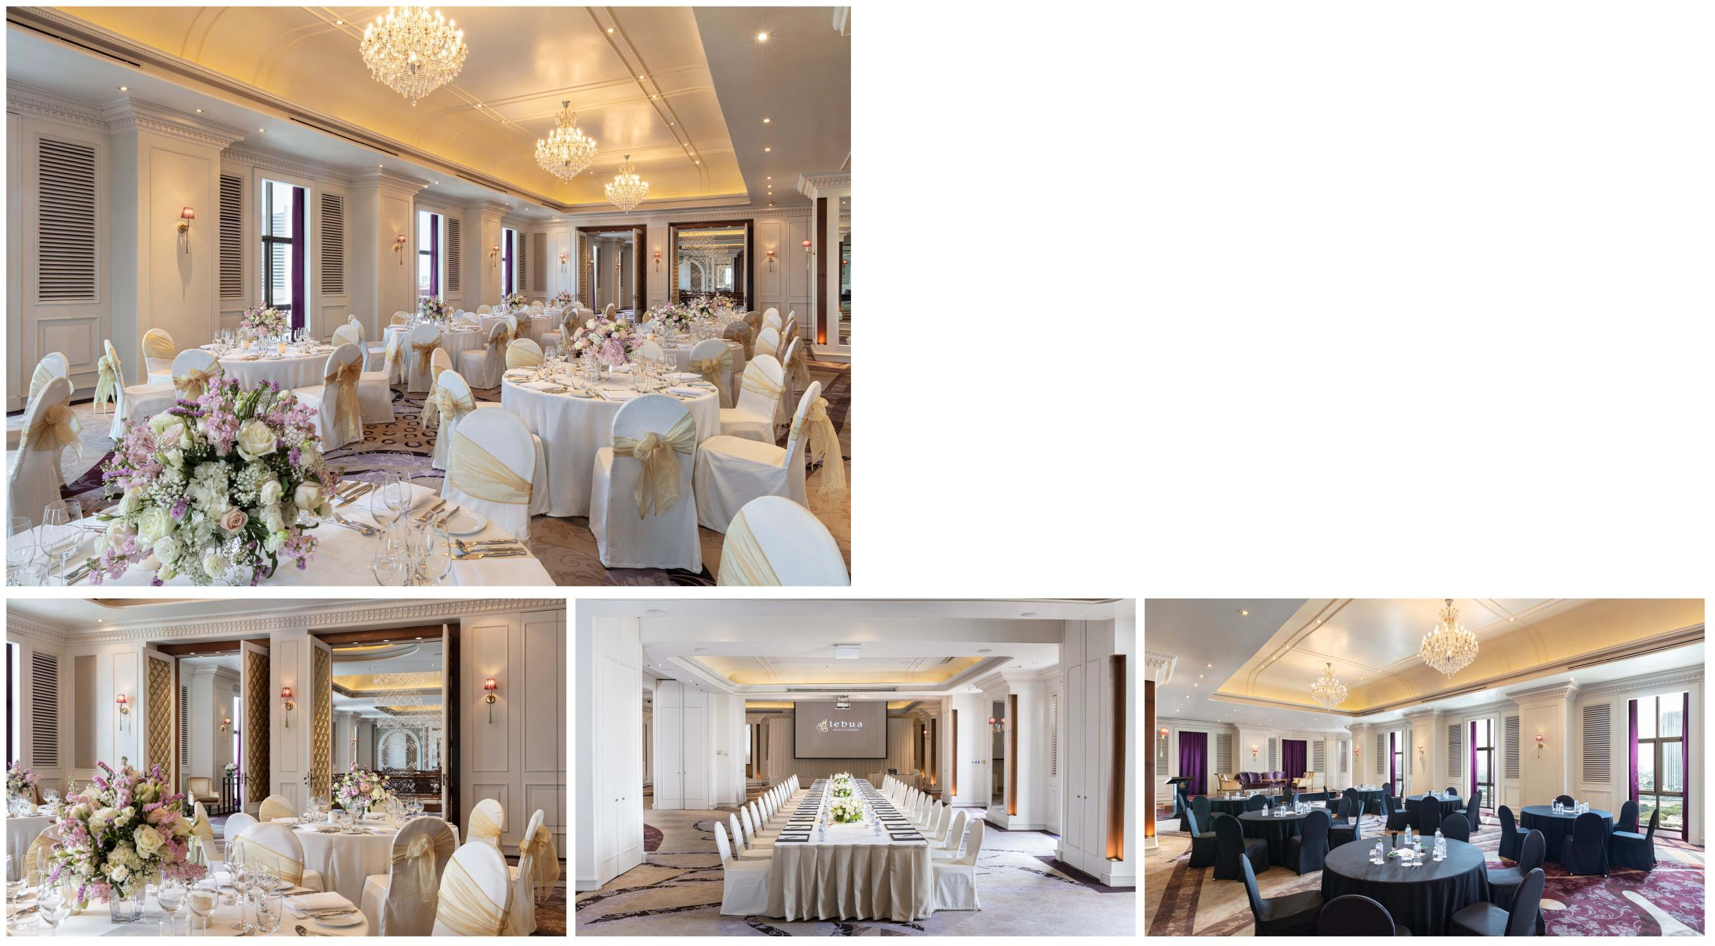

One of the most unique hotel function rooms in the country, the Pundarika Grand Ballroom exudes imperial grandeur, elevating every event held within its walls. Its ornate décor provides a stunning backdrop for wedding receptions and gala celebrations.
Capacity:
400 for seated dinners / 1,000 for standing receptions

Slide 5
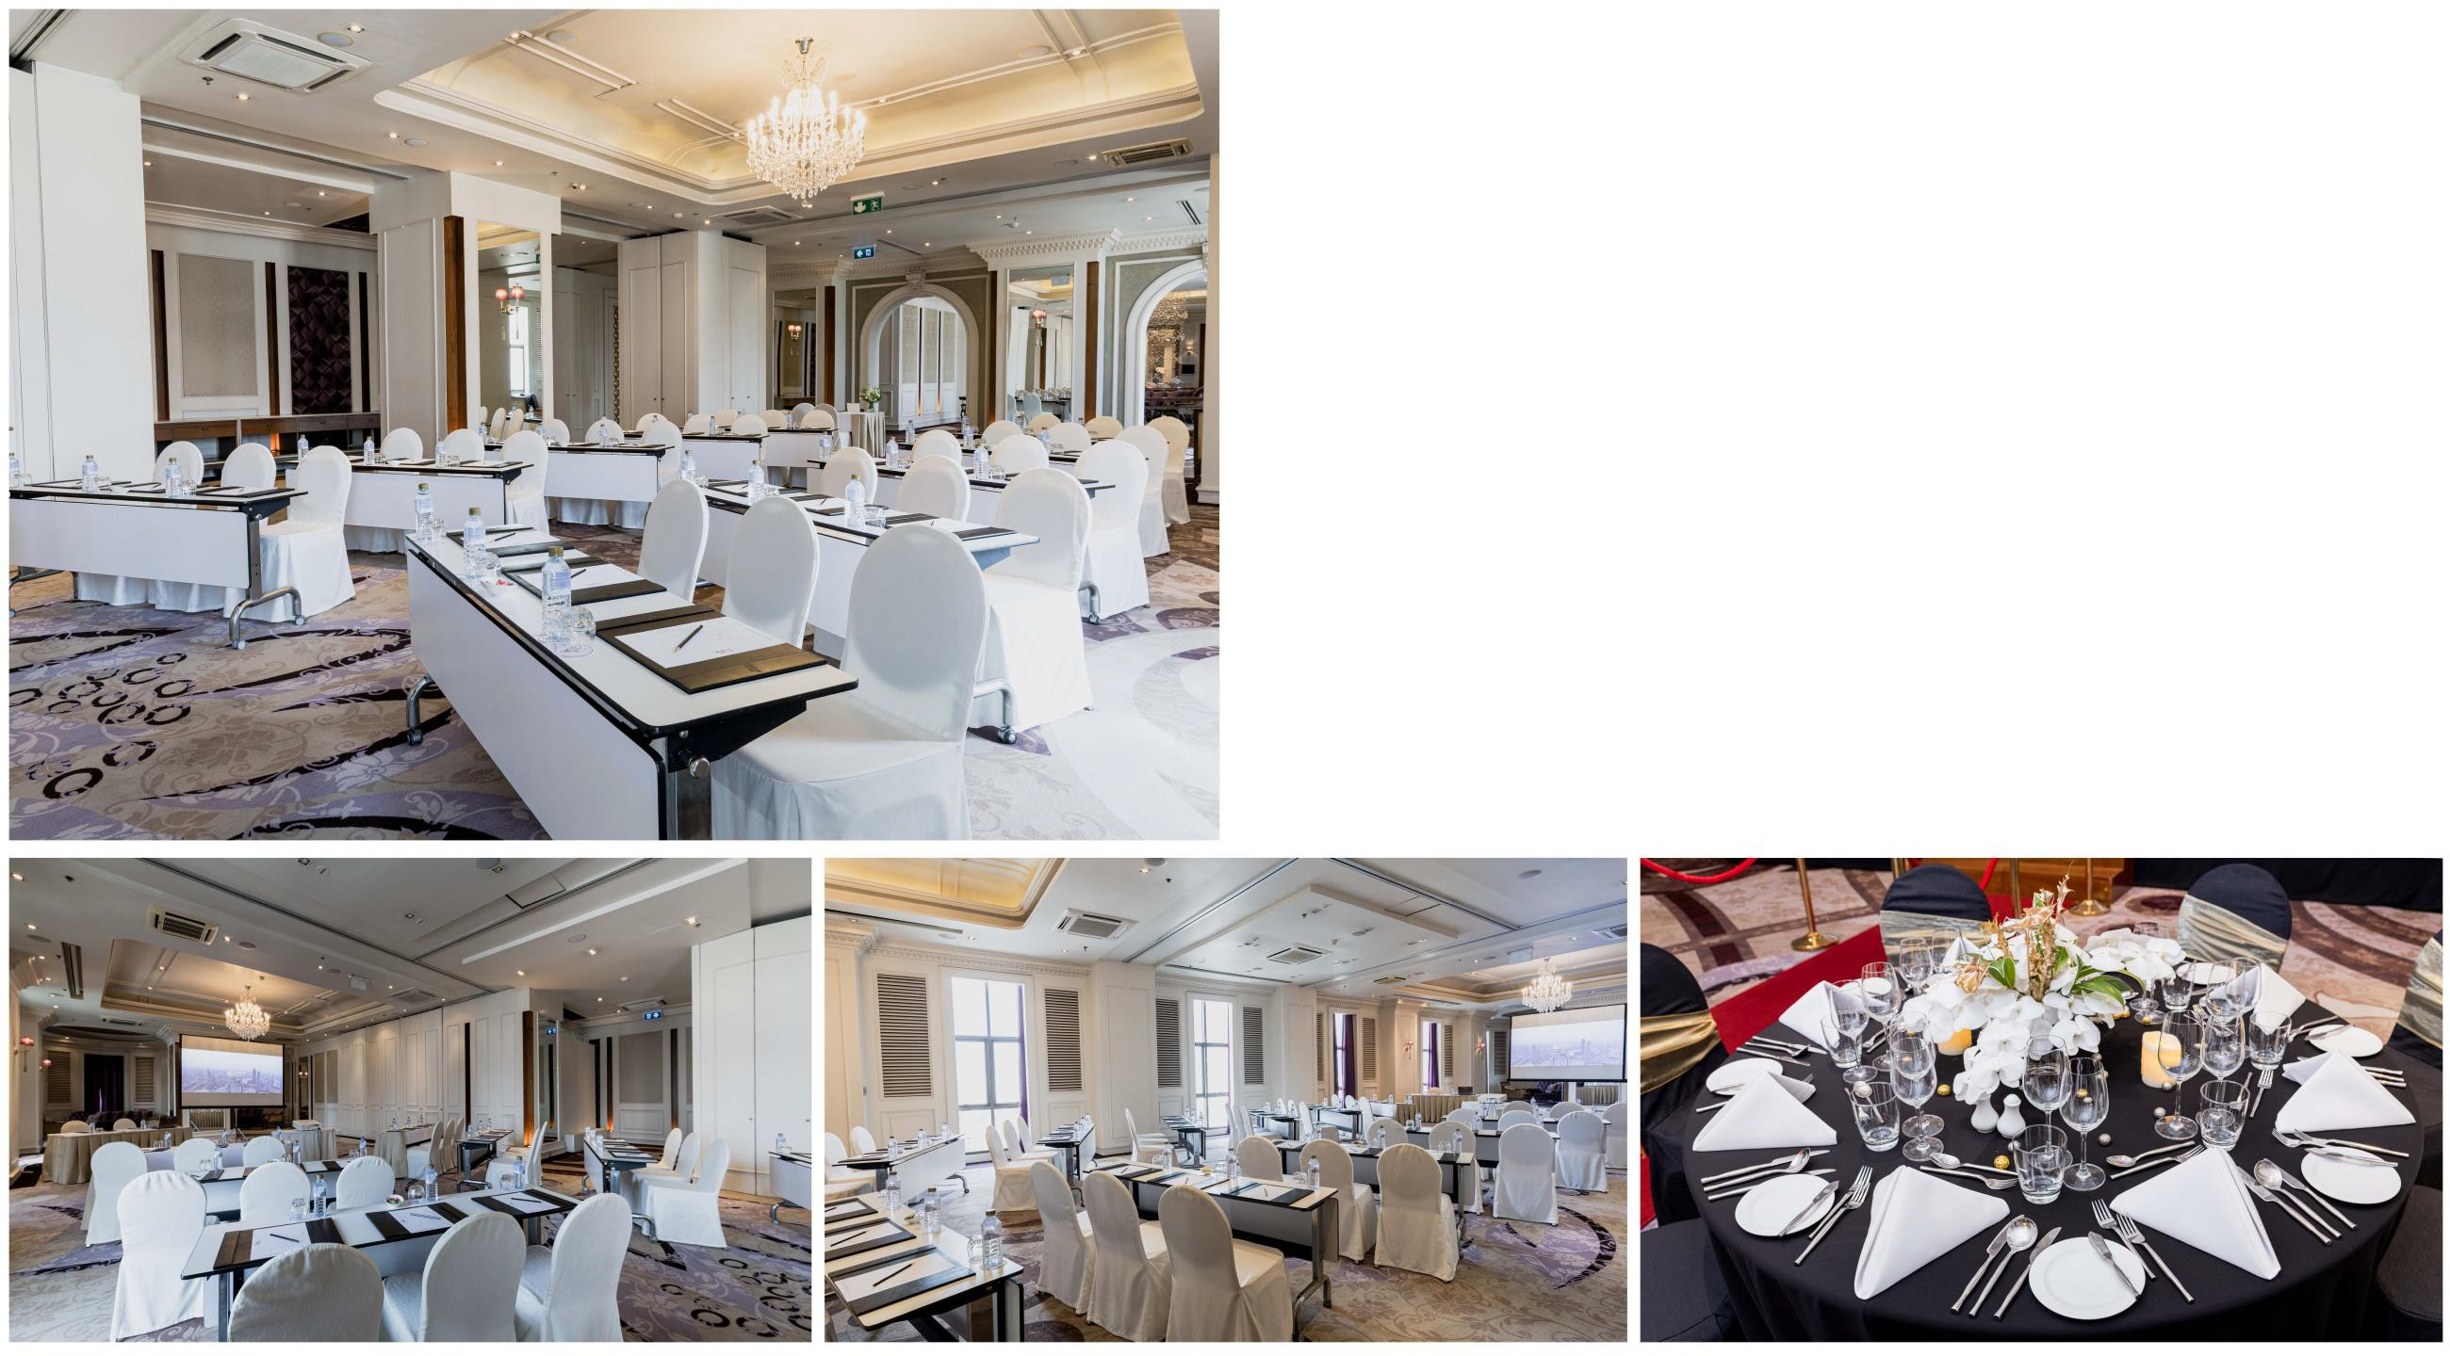
Pushkara Ballroom
Intricate details here been integrated with excellence in mind. This versatile hall can be sub-divided into three smaller units - Mallika, Kamala, Nalini, each overlooking the glittering Chao Phraya river.
Capacity:
120 for seated dinners / 300 for standing receptions

Slide 6
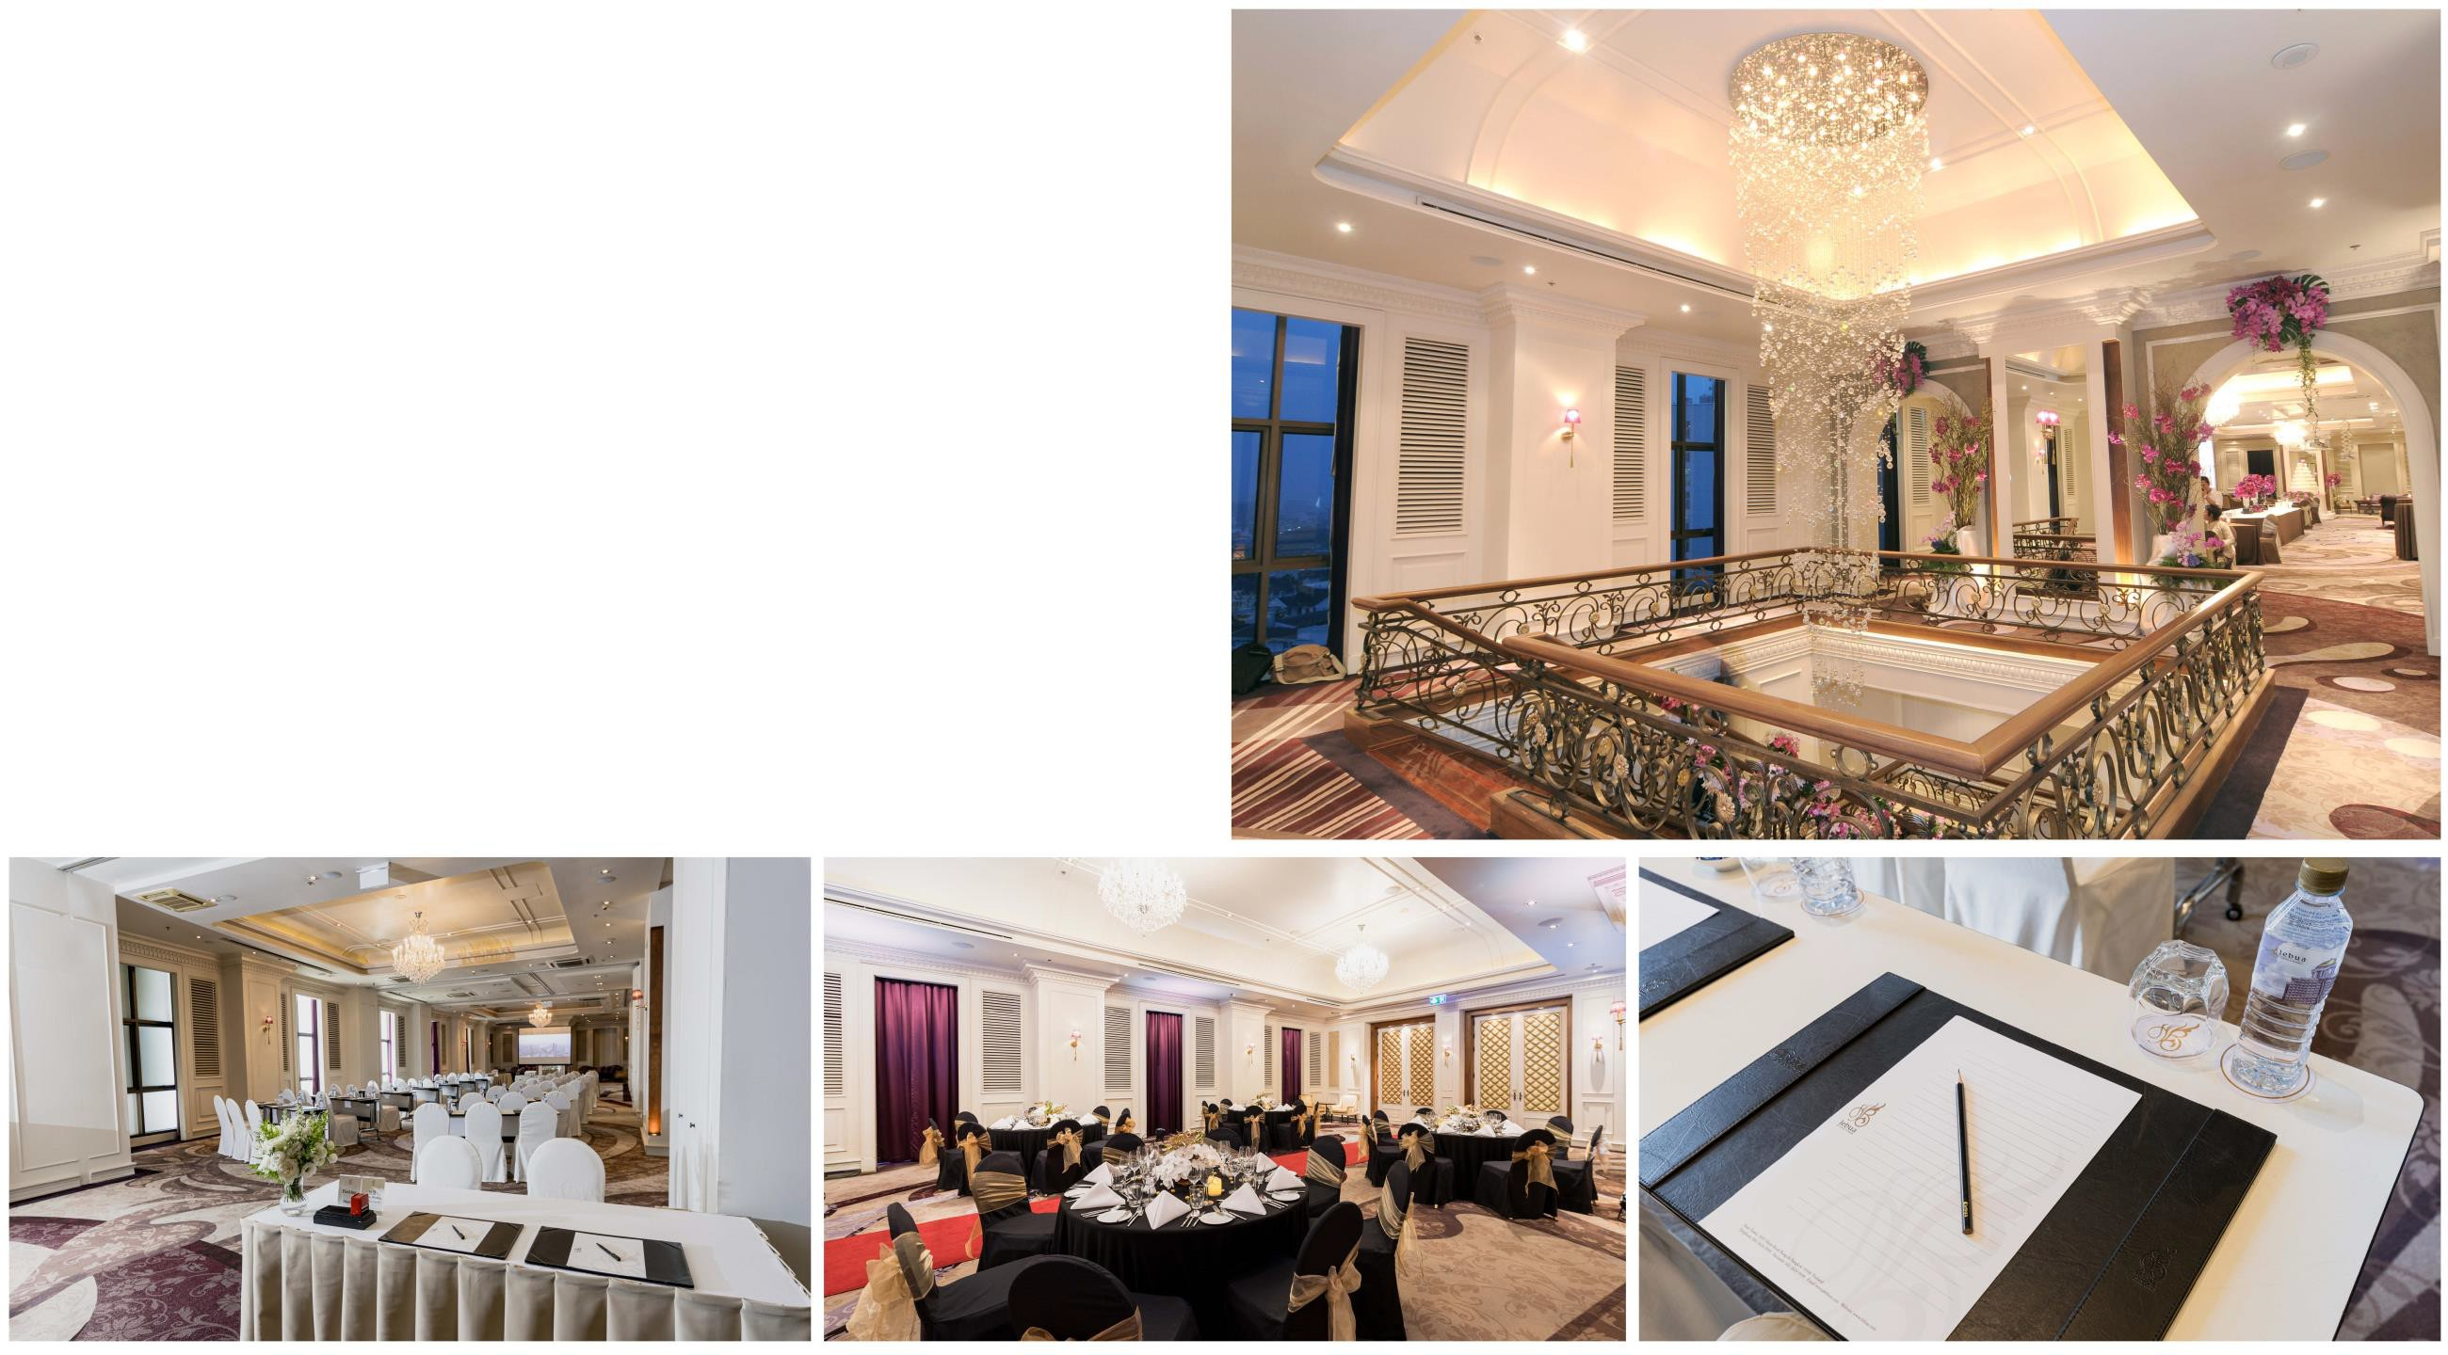
Angarika Ballroom
From a stunning chandelier taking center stage to charming old-world European elegance, everything about this function room is designed to dazzle.
Capacity:
250 for seated dinners / 600 for standing receptions

Slide 7
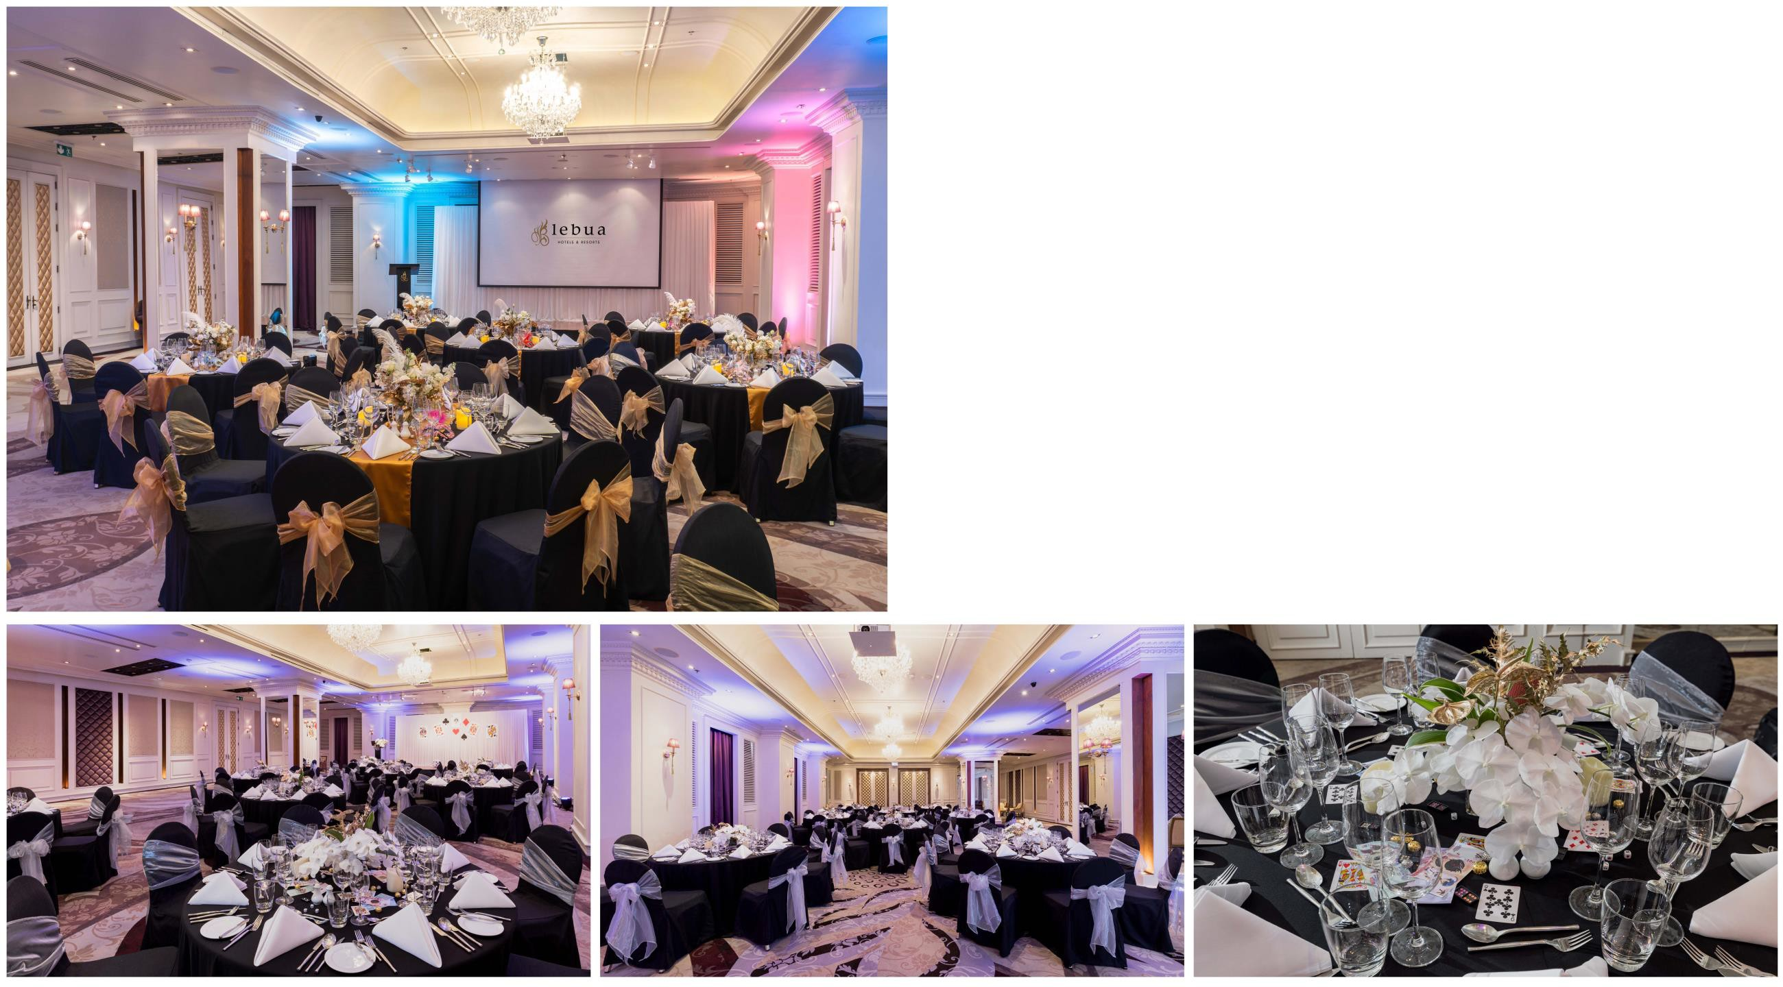
Aravinda Ballroom
The Aravinda Room offers a feast for the eyes in every way. With breathtaking views of the Chao Phraya River, this elegantly designed, spacious venue is perfect for exclusive wedding celebrations, adding a touch of romance to every moment.
Capacity:
120 for seated dinners / 300 for standing receptions

Slide 8
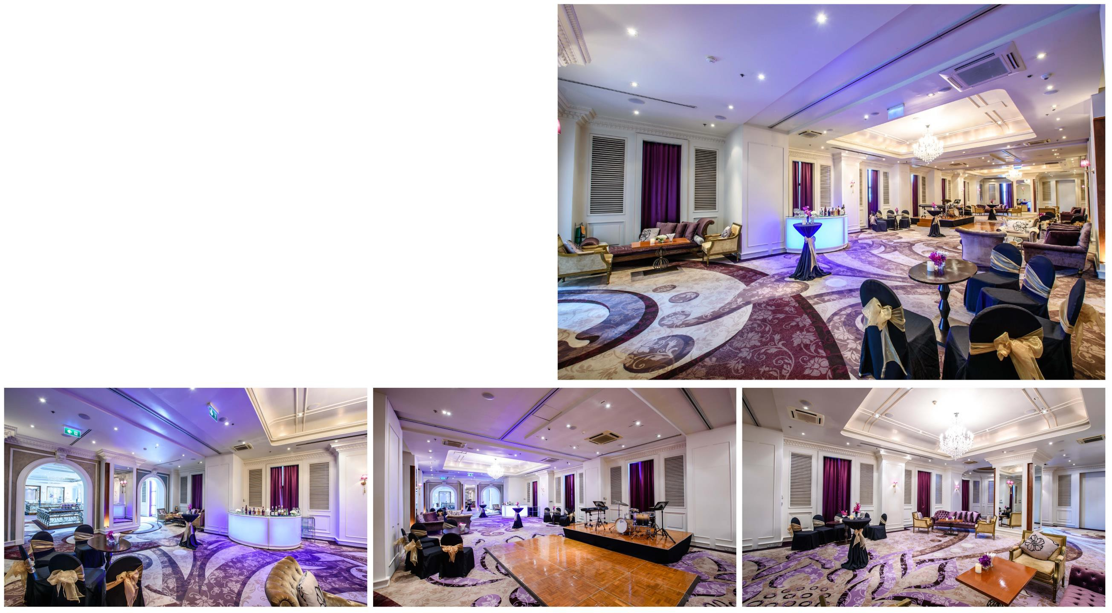
Padma Ballroom
Padma Ballroom is designed to adapt to diverse needs.
The function room can be sub-divided into three smaller unit - Pamini, Padmana and Padmavati, to make it perfect for special seminars, private business meetings as well as large conferences.
Capacity:
150 for seated dinners / 300 for standing receptions

Slide 9
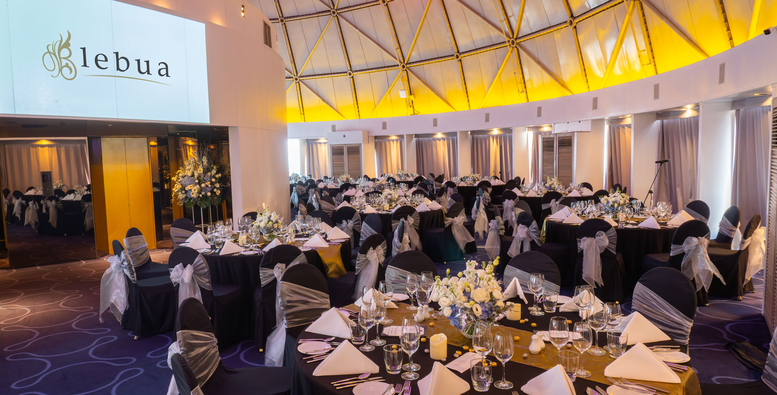
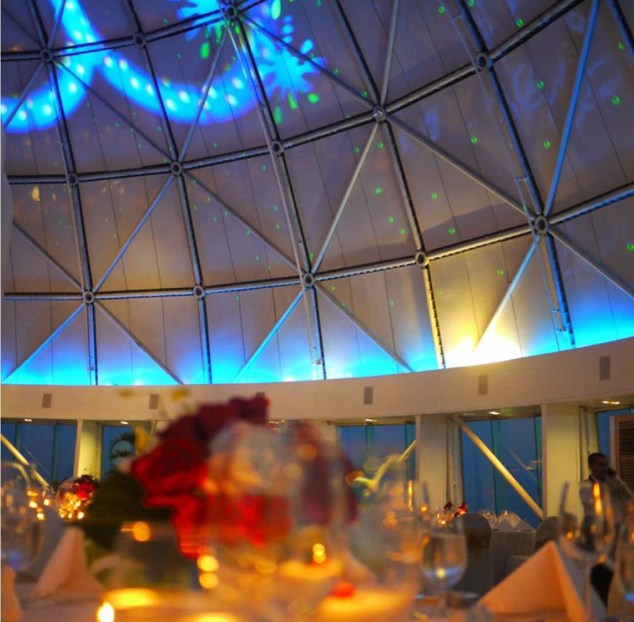

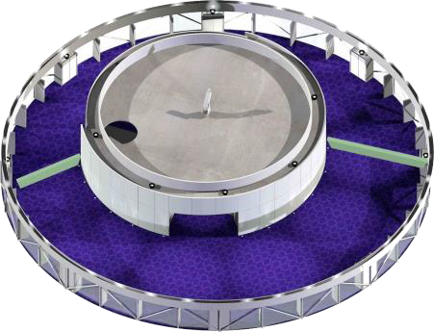
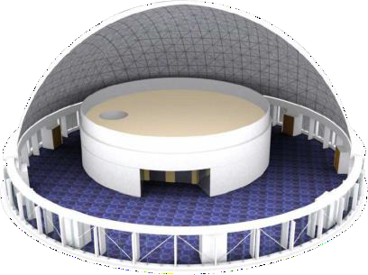
State Room
The State Room sits majestically atop The Dome, offering an unparalleled setting for exclusive events. Its circular ceiling enhances acoustics, ensuring a resonant and immersive experience, while the 360° panoramic view provides a breathtaking backdrop. Simply put, any event held in The State Room is destined to be extraordinary.
Capacity:
150 for seated dinners / 300 for standing receptions

Slide 10
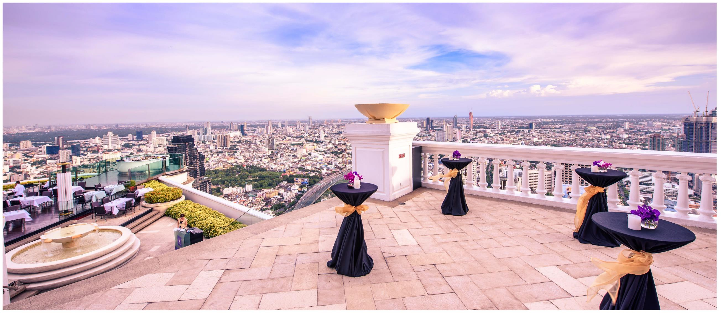
Vantage Point

Slide 11
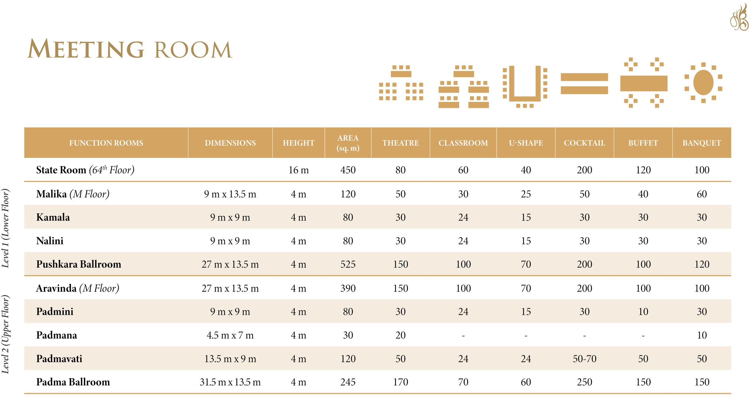

Slide 12
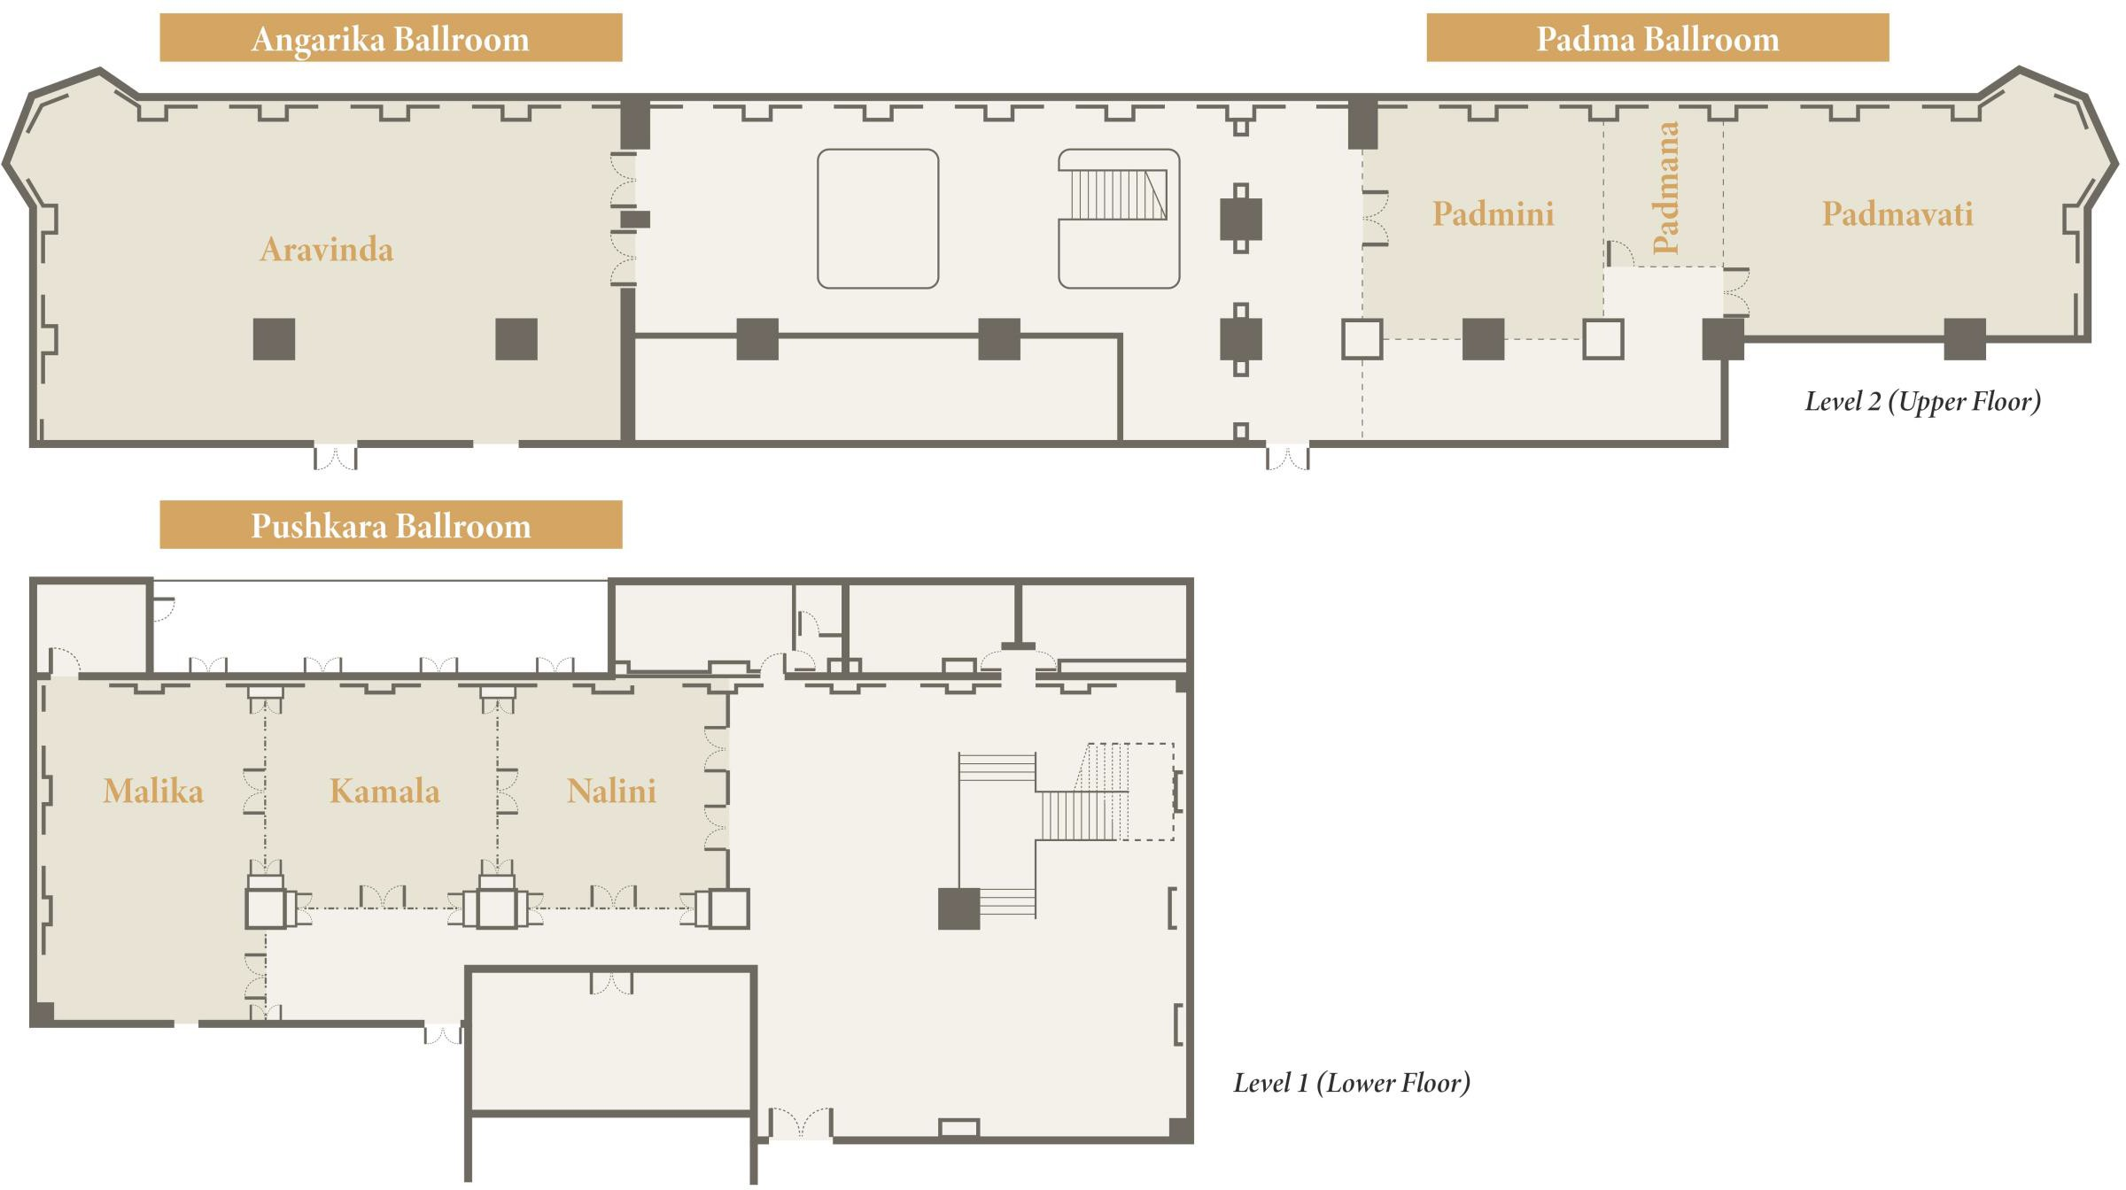

Slide 13
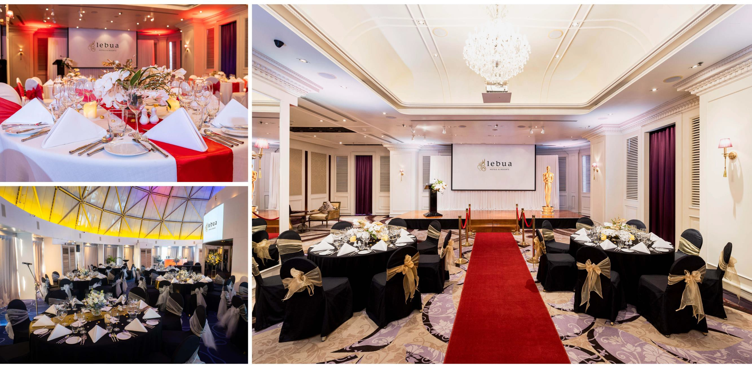

Slide 14
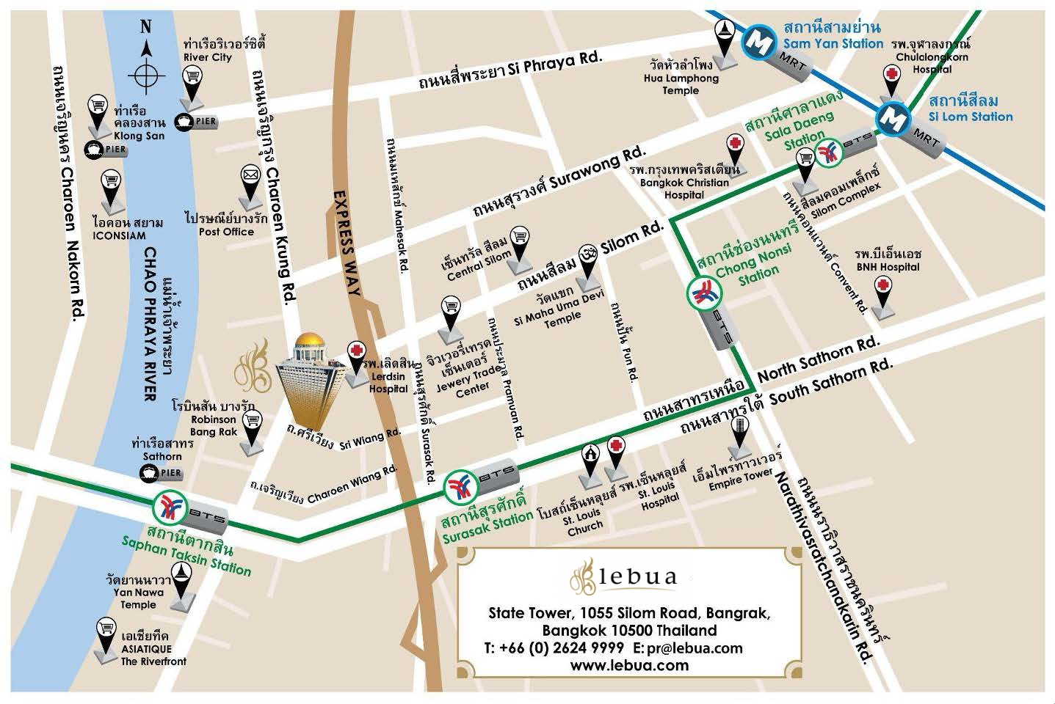
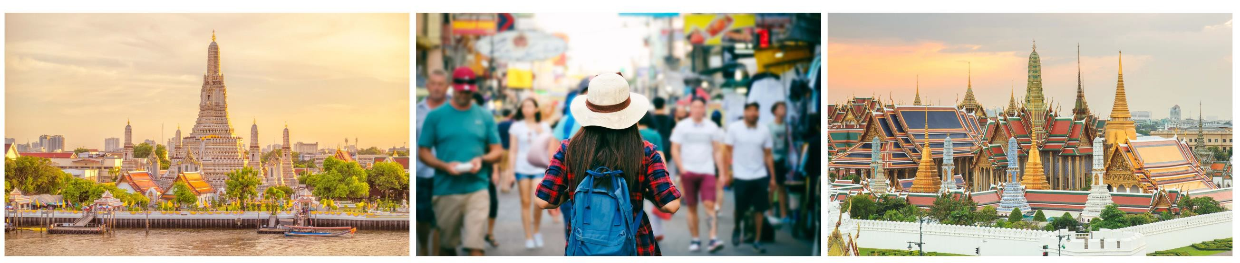
Location
The property is 40 minutes from Suvarnabhumi International Airport Situated near the Chao Phraya River
500 meters from Saphan Taksin BTS Station and Sathorn Pier. (10-15 minute walk)
Local Area - Bangrak filled with bars, restaurants, shops, street
food, markets
Sukhumvit is approximately 15-20 minutes by taxi.
Grand Palace - 6 kilometers away
Wat Arun - 7 kilometers away
Chatuchak Weekend Market - 11 kilometers away

Slide 15
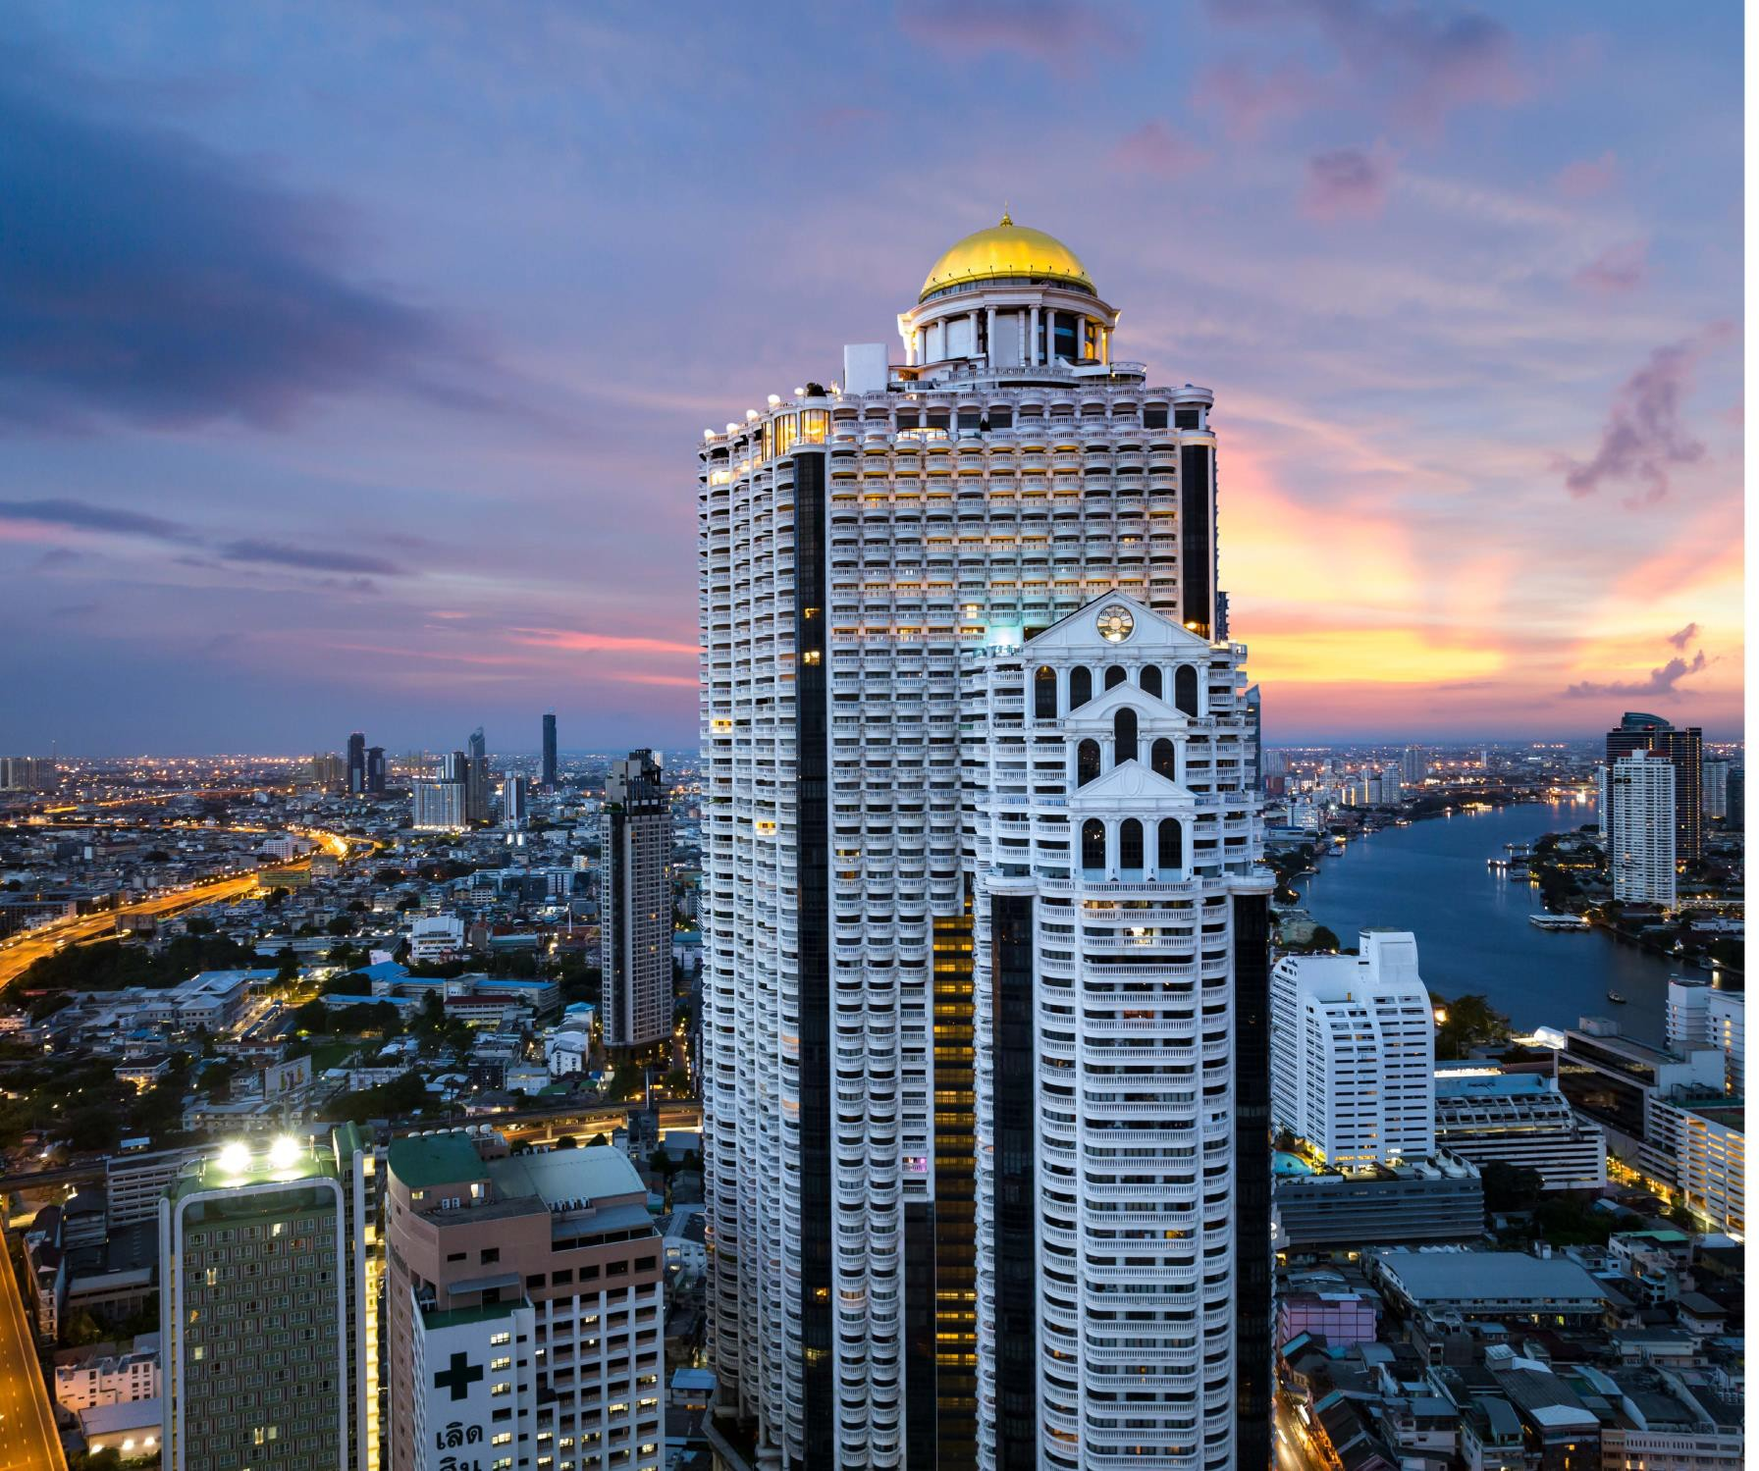
1055 Silom Road, Bangrak, Bangkok 10500 Thailand
T: +66 (0) 2624 9999
F: +66 (0) 2624 9998
Email: sales@lebua.com

